Slide 1
Weekly meeting
8 22 2024
Ty Bottorff

Slide 2
Outline
MT variants
Epigenetics

Slide 3
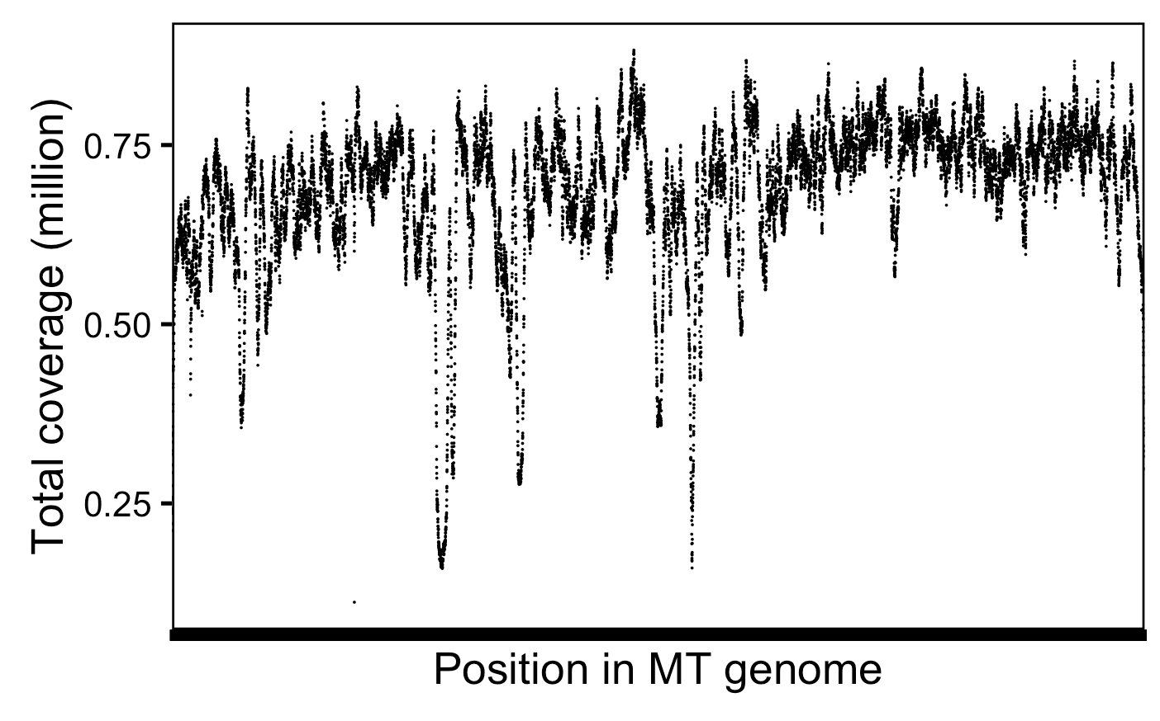
With reseq, cover MT genome to ~680k X depth
Notes:
# mean across positions and libs is 13,697 reads covering a specific position per lib, so that's 50*13,697 = ~680k X depth or coverage
Got the same # doing sum(combined_coverage_data$coverage) / 16569 (MT genome size)

Slide 4
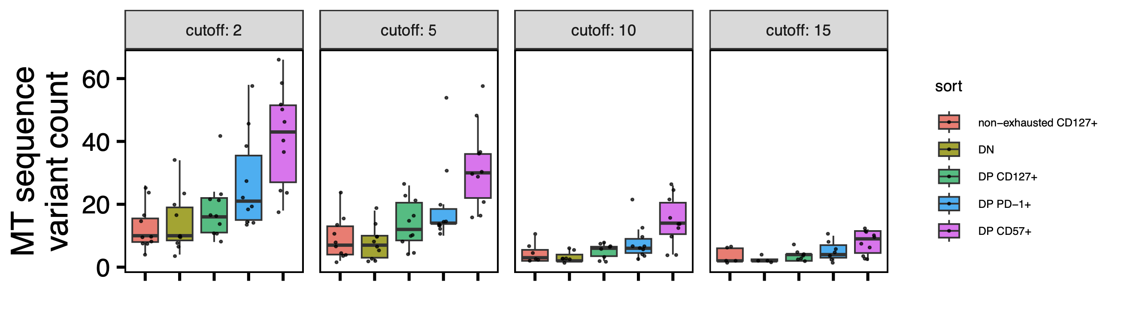
Still observe DP CD57⁺ having most MT SNV variants across various supporting read cutoffs
*stats not tested
Notes:
Lowest min_var_freq used here
Cutoff of 2 is what I’ve used elsewhere/previously
Cutoff means # of supporting reads for var or ref on both strands (+/-)
filter(var_supporting_reads_on_plus_strand > cutoff,
var_supporting_reads_on_minus_strand > cutoff,
ref_supporting_reads_on_plus_strand > cutoff,
ref_supporting_reads_on_minus_strand > cutoff)

Slide 5
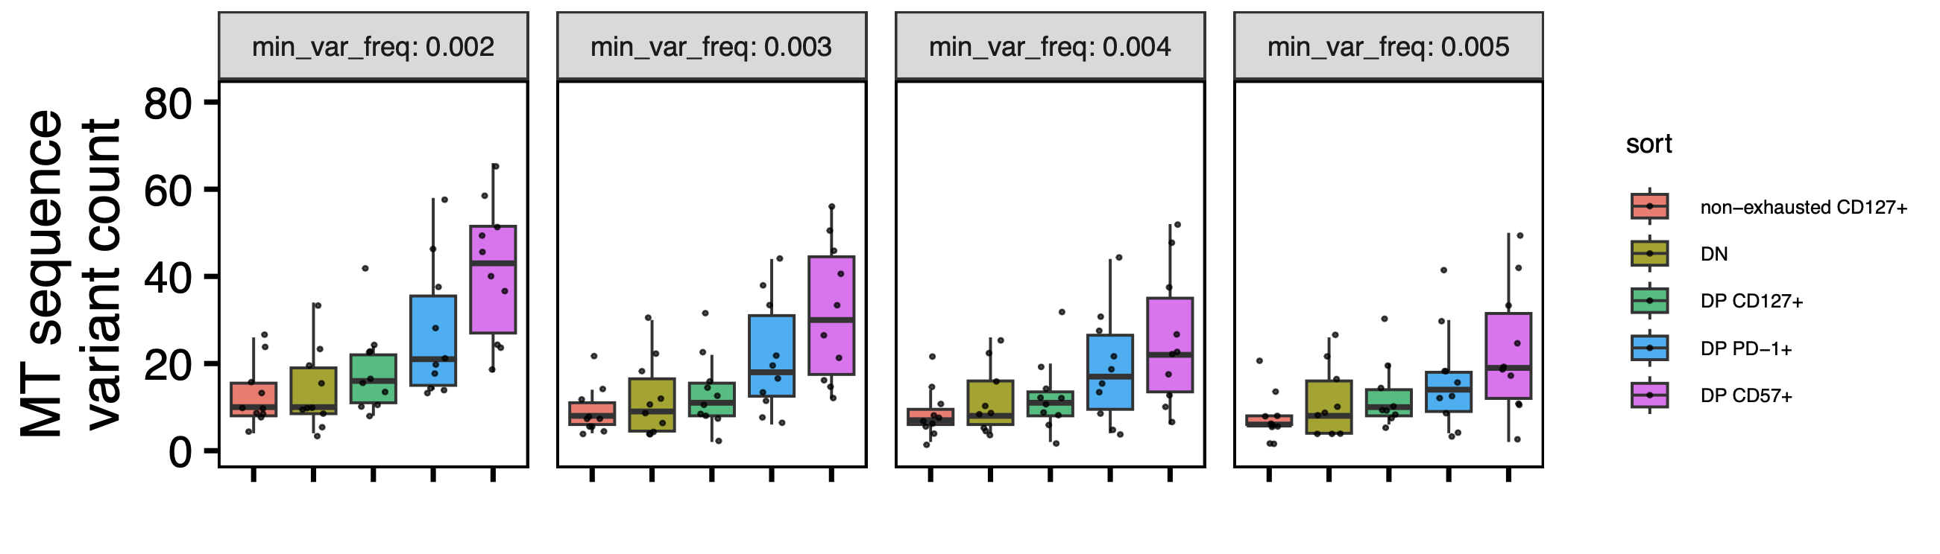
Trend strength increased with lower min_var_freq
0.003 is the highest min_var_freq with padj significances
(same comparisons as 0.002)

Slide 6
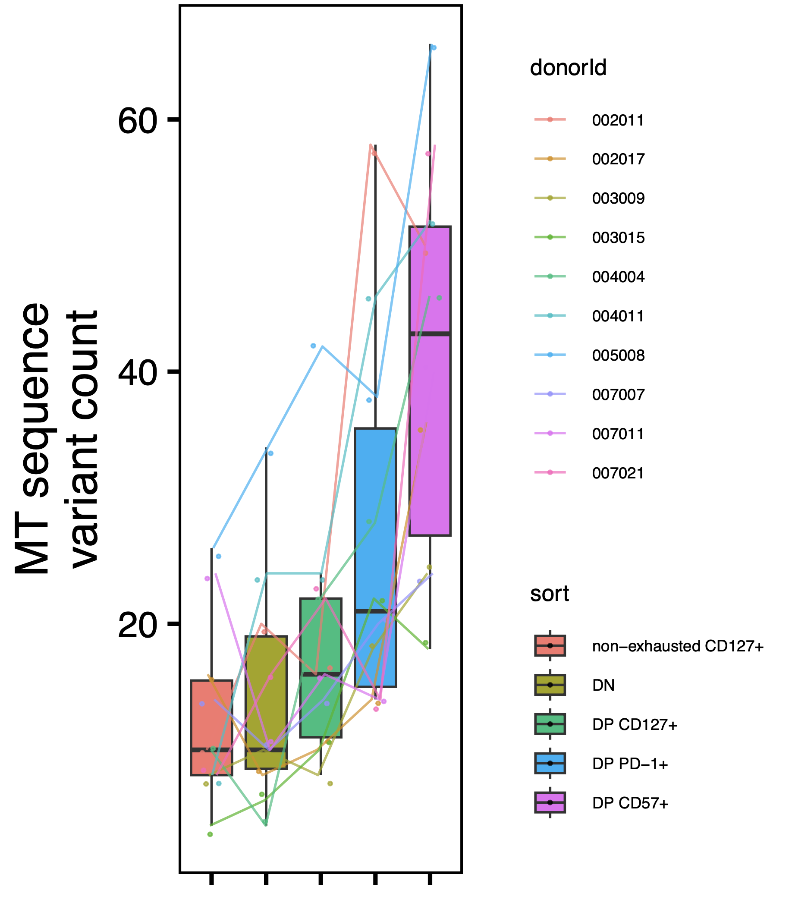
Paired wilcox tests have ~same significance conclusions, minimal donor effect
Notes:
So sort to sort variation > donor to donor variation?

Slide 7
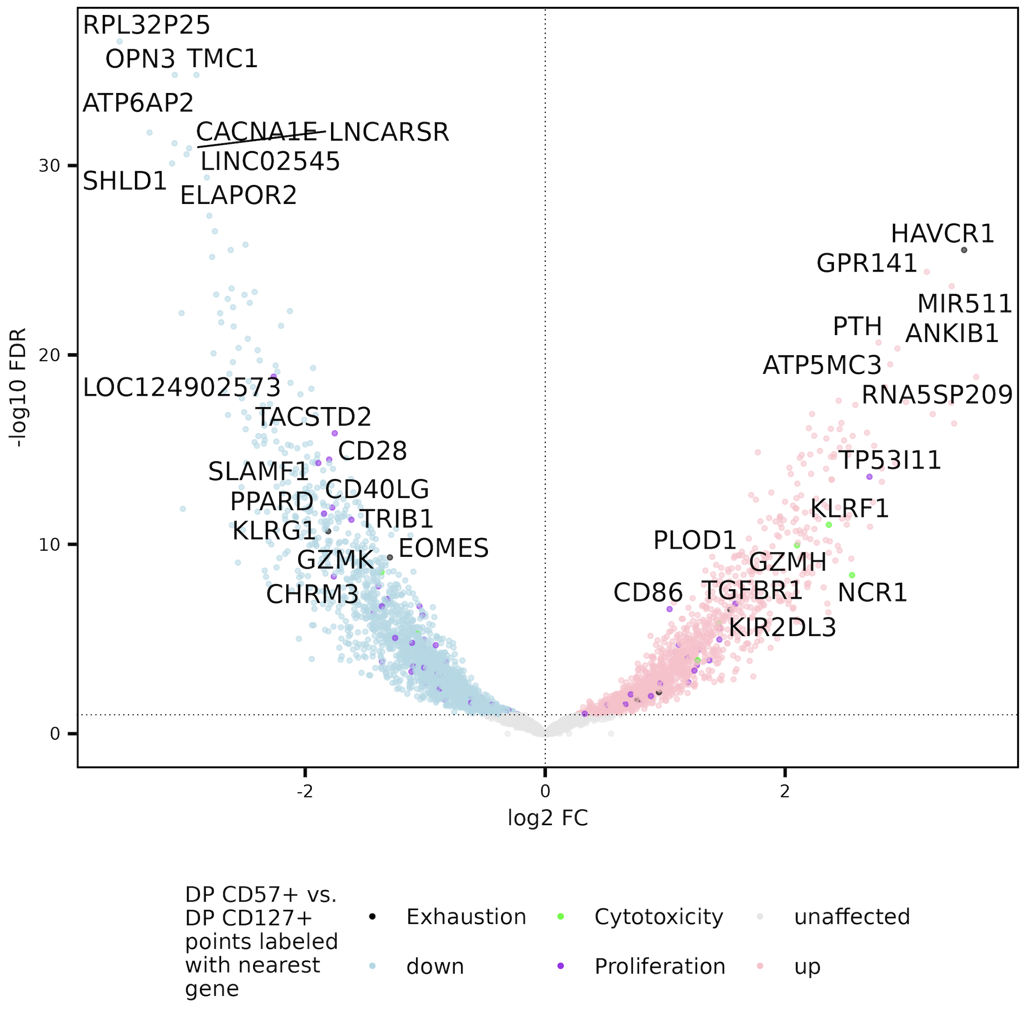
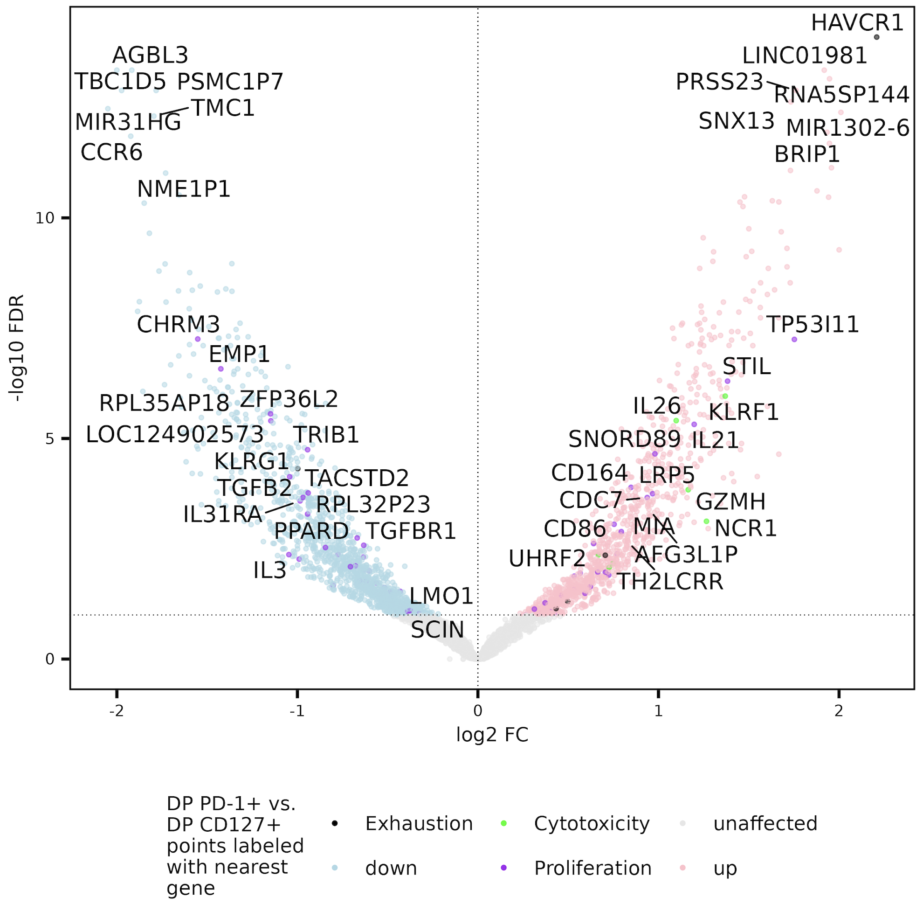
Peak near HAVCR1 gene less accessible in DP CD127⁺ vs. both other DPs, perhaps DP CD127+ less T_{ex}
Notes:
Top right hit is for HAVCR1 (IR), so maybe DP CD127 actually yes less Tex than other DPs
EOMES not always exh
grouped by nearest gene & nearest promoter before slicing to get unique peaks (so will still see ”duplicates” meaning different nearest gene and promoter)
This wasn’t visable before I don’t think (at least not in both contrasts) pre-reseq

Slide 8
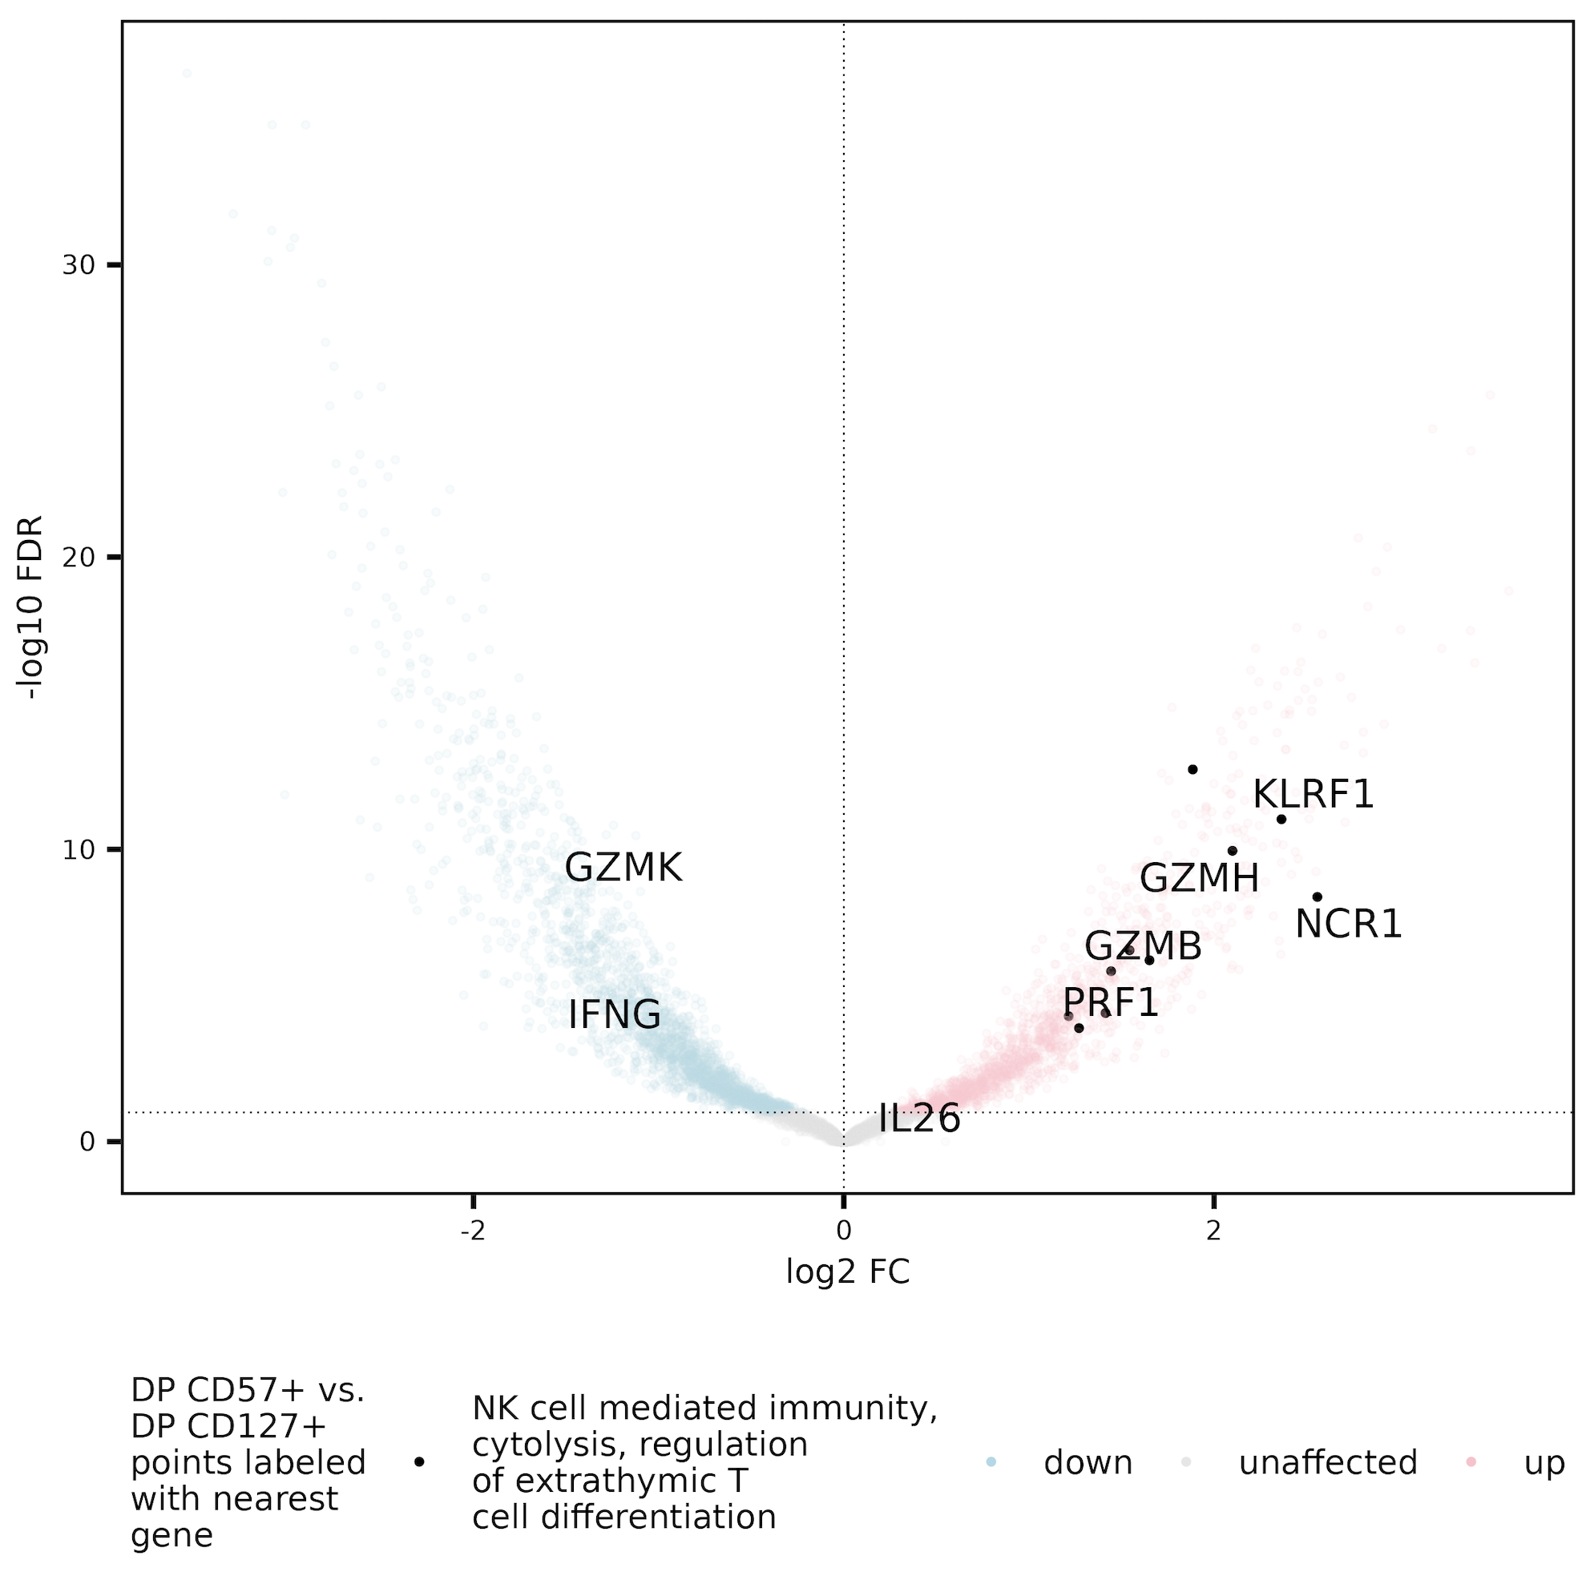
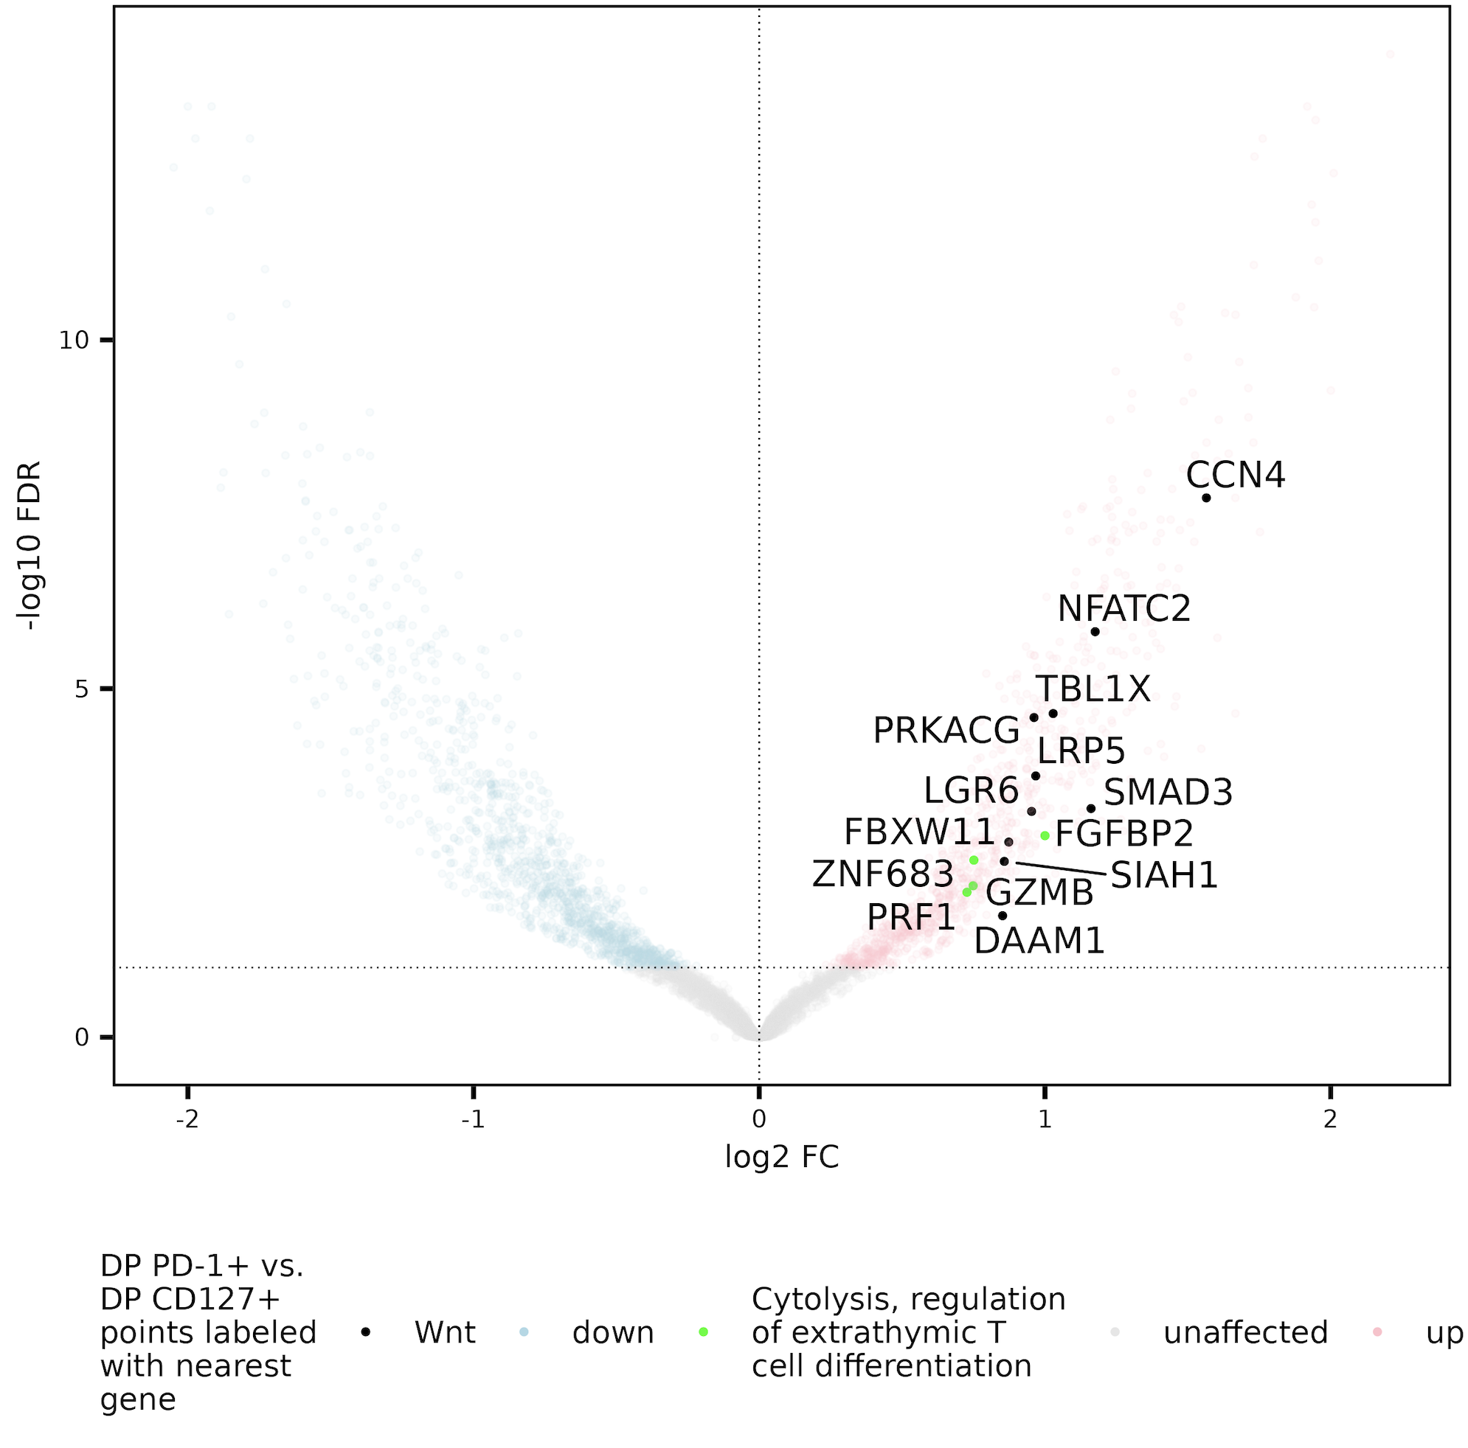
Cytolysis, regulation of extrathymic T cell differentiation gene sets enriched in DP PD-1⁺/CD57⁺ sorts vs. DP CD127⁺, so perhaps DP CD127⁺ also less T_{eff}?
Notes:
The most correct way to say title is this set (genes close to peaks more accessible in DP PD-1+ vs. DP CD127+) is enriched relative to whole genome

Slide 9
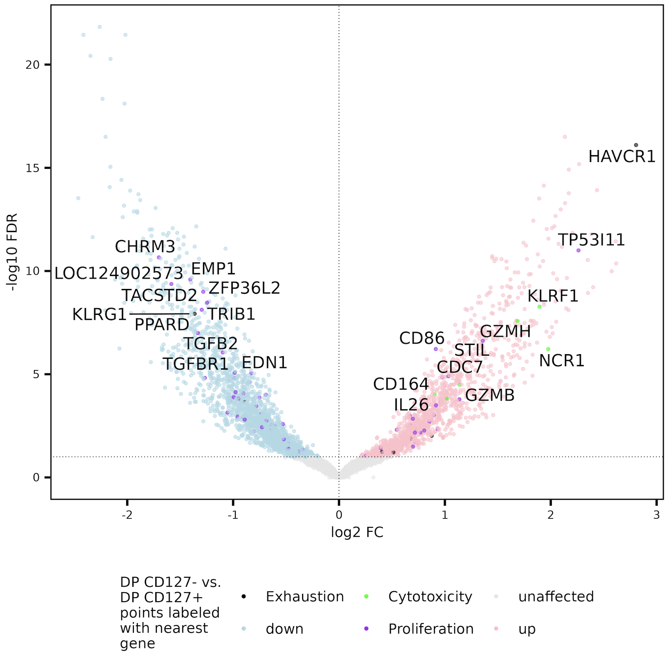
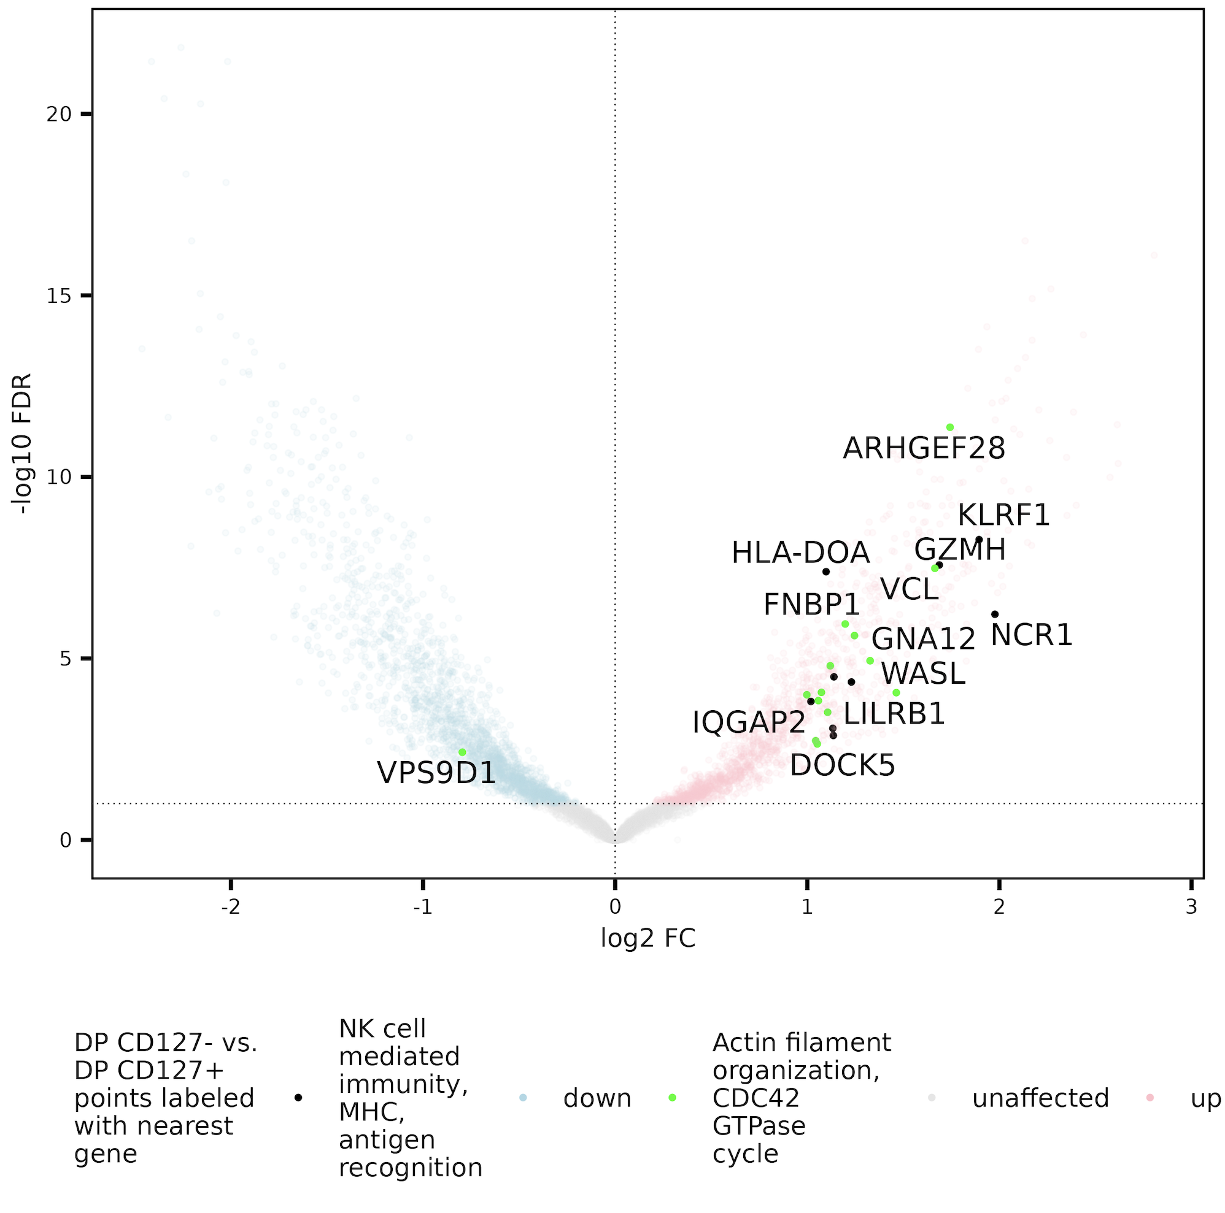
Consistent results with combining DP CD127⁻ groups in analysis

Slide 10
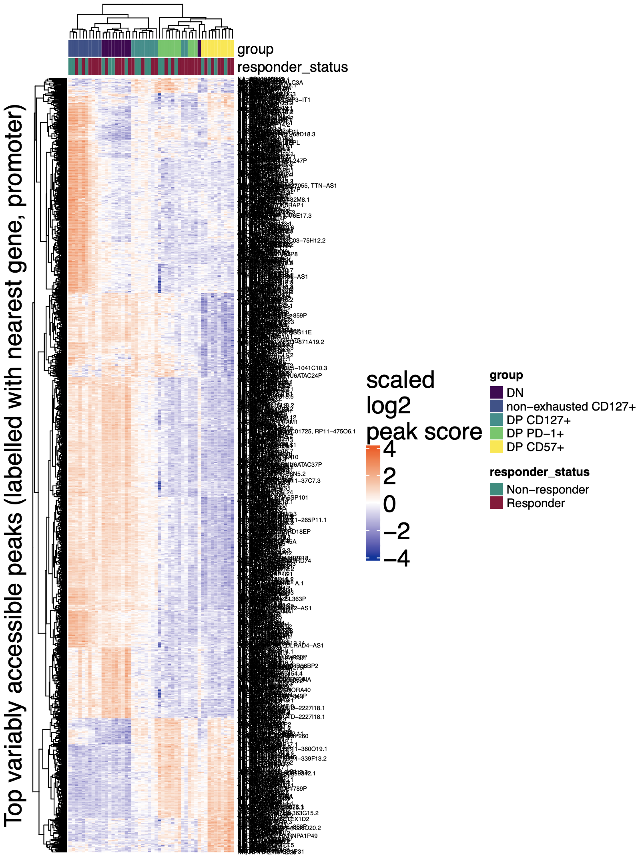
Also see enrichment of T cell differentiation (as well as regulation of immunoglobulin mediated immune response, developmental processes) in bottom block here (accessible in DP CD57⁺ and DP PD-1⁺)

Slide 11
Conclusions
MT variants: choosing params
Ref/var supporting reads cutoff fine at 2/strand
min_var_freq of 0.003 (lowest w/ strongest results)
Epigenetics
Proliferation gene set doesn’t seem enriched in any side of contrasts looked at so far (CD127 related ones)
DP CD127+ both less T_{ex} (HAVCR1 peak less accessible) and less T_{eff} (cytolysis gene sets less accessible)?
Notes:
Point 2a: contrary to hypothesis that DP CD127⁺s for example may associate with worse outcome due to proliferating more

Slide 12
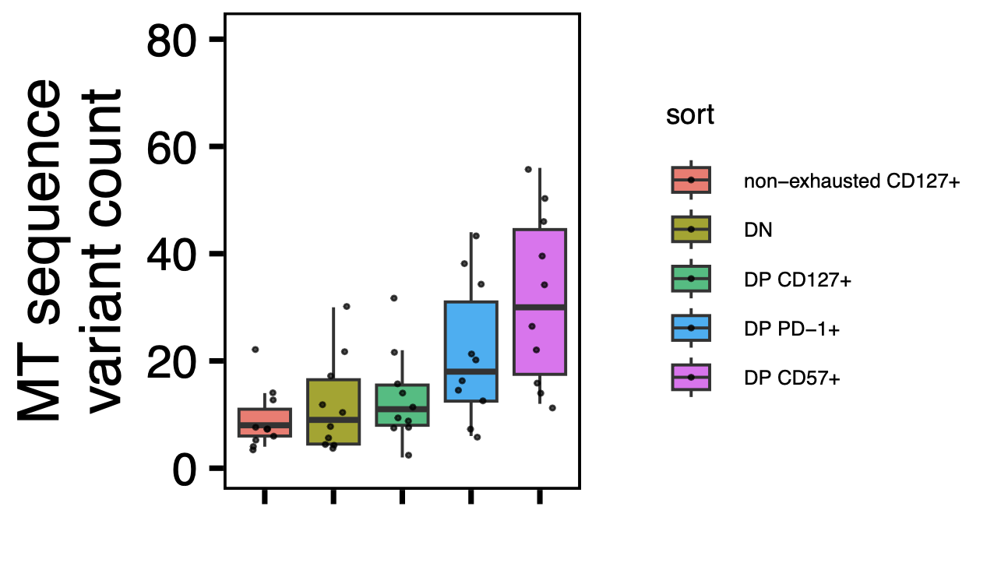
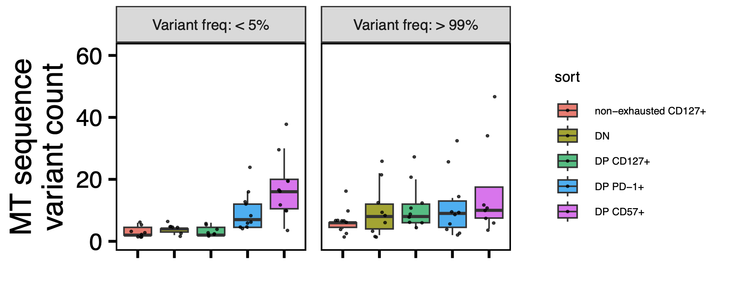
Next steps
Prepare slides for Long lab reseq update
TEAseq analysis
w/ stats added

Slide 13
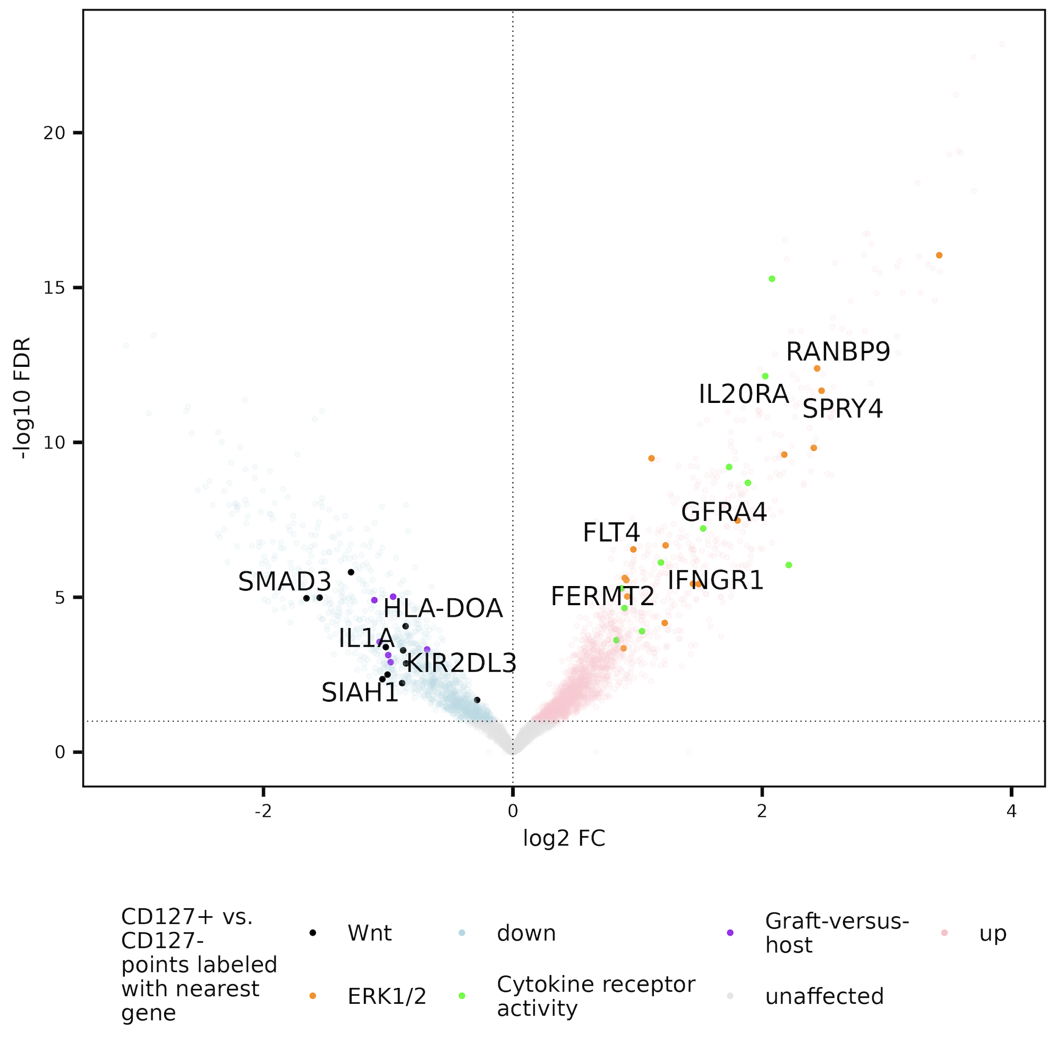
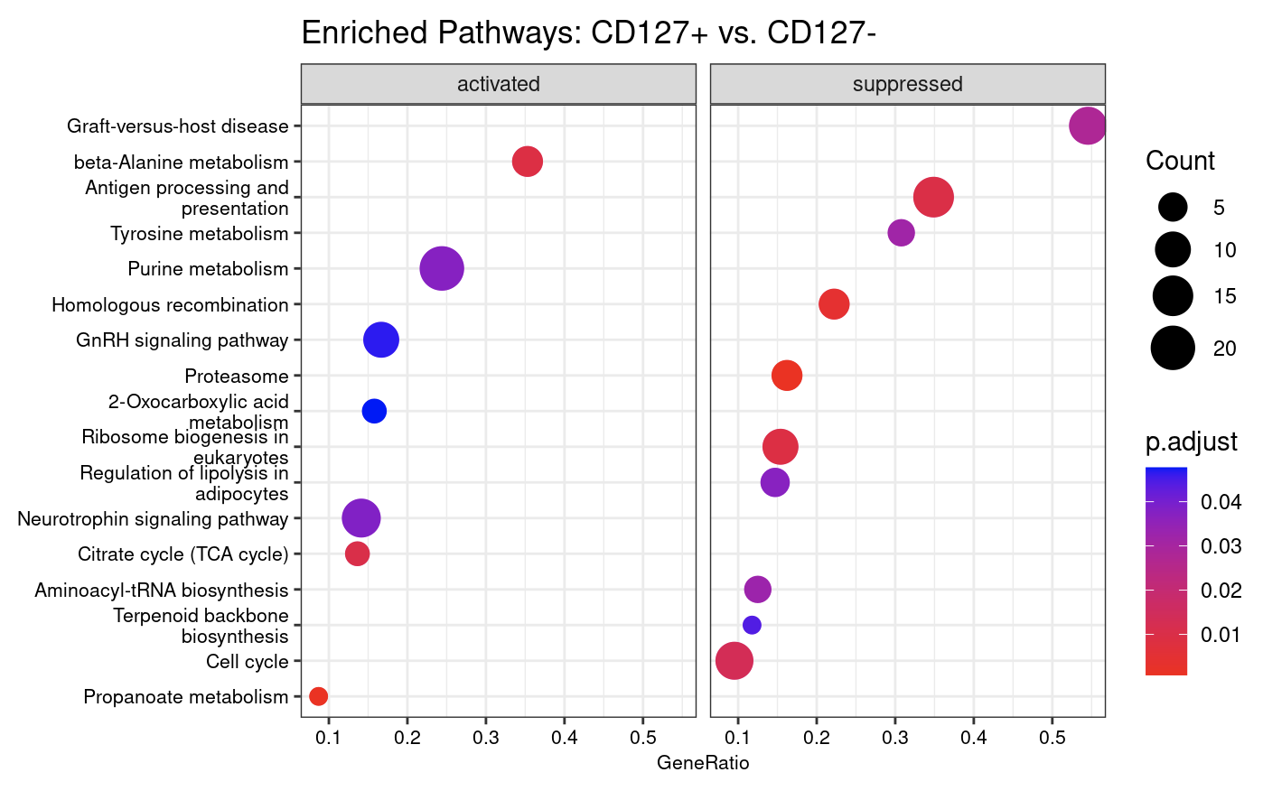
Enriched gene sets in grouped CD127⁺ vs. grouped CD127⁻
Along with ERK1/2, also see MAPK, general intracellular signal transduction up in CD127⁺

Slide 14
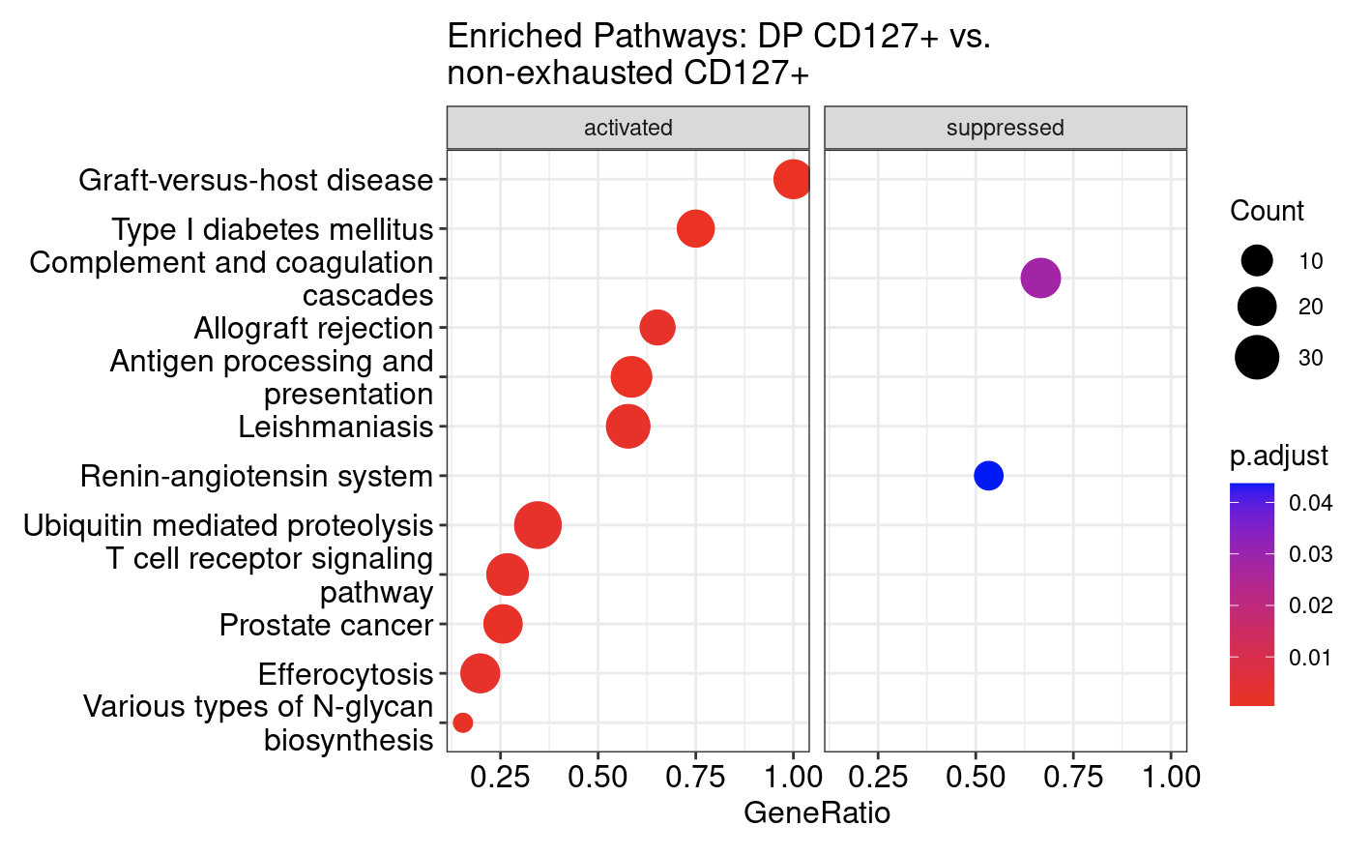
Do observe many enriched sets with stringdb/kegg methods for DP vs. non-exhausted CD127⁺

